Slide 1



Integrated Program in Business Analytics
CREDIT CARD FRAUD DETECTION
GROUP M

Slide 2
Agenda
Business Problem and Objectives
Executive Summary
Data Overview and Key Business Assumptions (if any)
Data Preparation and Pre-processing
Sanity checks, treatment and transformations for analytical dataset preparation
Exploratory Data Analysis
Key Business Findings and Insights
Model Development and Validations
Model comparisons on key scoring metrics and model finalization
Dashboarding (required only when it is in scope of analysis)
Business Recommendations and Potential Business Impact
Next Steps
Appendix

Slide 3
Business Problem
The Primary Challenge is to identify potential fraudulent credit card transactions.
Objectives
Enhanced fraud detection capabilities.
Reduced financial losses.
Improved customer trust and satisfaction.
Compliance with regulatory standards.
Executive Summary
The aim of the project is to use data driven insights to create a machine learning model for fraud detection amongst credit card transactions.

Slide 4
Data Overview
We have a dataset of 1,852,394 credit card transactions on 999 credit cards for years 2019 and 2020.
Key Business Assumptions
Transaction Authenticity
Data Quality
Model Deployment
Unless flagged ,transactions are considered to be genuine.
Models are deployable in the real business environment.
Data is reliable.

Slide 5
Data Preparation and Pre-processing
Sanity Checks
Treatment
Transformations
Checked the data type and unique values for all columns.
Extracted features like year, month, day of the week, hour, time lapse and age.
Transformed Outlier so that extreme values do not affect ML model.
Converted categorical data into numerical values.
Checked if any duplicate values are present.
Dropped insignificant columns to clean the data.
Variable Transformation to treat skewness.
Checked for missing values in dataset.
Created symmetric dataset for feature engineering and model training.
Scaled features of all columns.

Slide 6
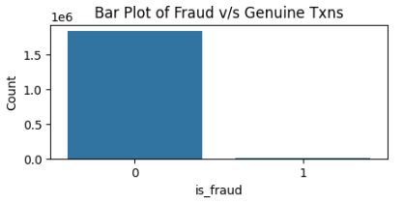
Exploratory Data Analysis
Comparing The Number of Transactions
Comparing The Amount of Spend
Total Amount Spent
Fraud Spent
3.95%
99.48% Genuine Transactions
0.52% Fraud Transactions
We see that while the number of fraud transactions is a mere 0.52% , the value of fraud spend is 3.95%.

Slide 7
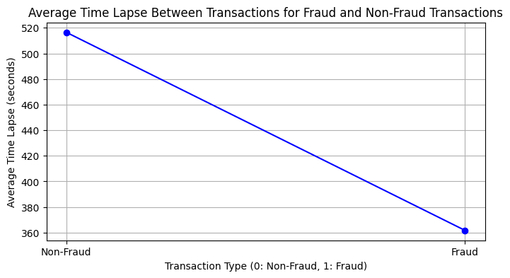
Average Time Lapse between Transactions
The time difference between fraud transactions is lesser than genuine transactions.

Slide 8
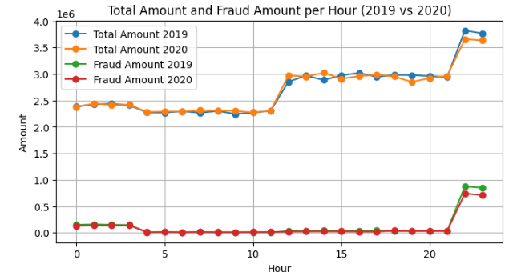
Hourly Spend
Maximum transactions occurs from 11:00 am till 11:00 pm.
Maximum fraud transactions occurs from 10:00 pm until 3:00 am.

Slide 9
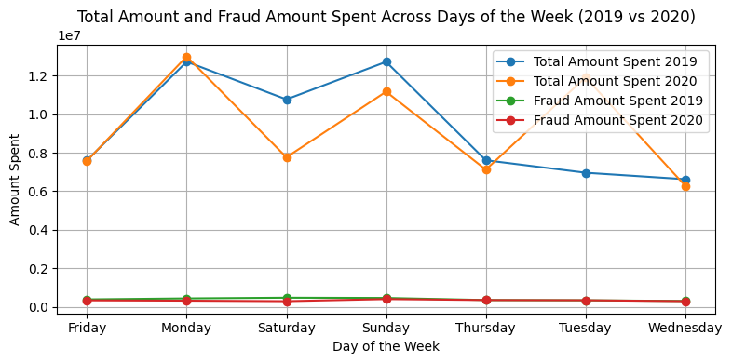
Day-wise Spend
The fraud spend on different days of the week is similar in both years.

Slide 10
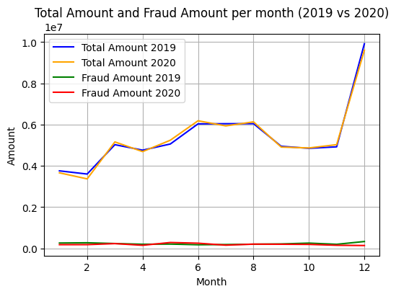
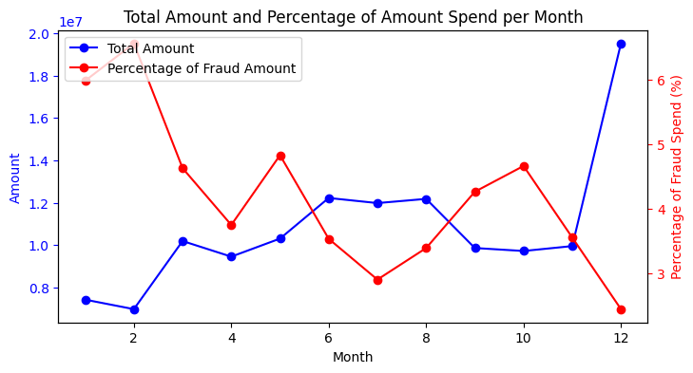
Month-wise Spend
Months with higher total spend have lower percentages of fraud spend and vice versa.

Slide 11
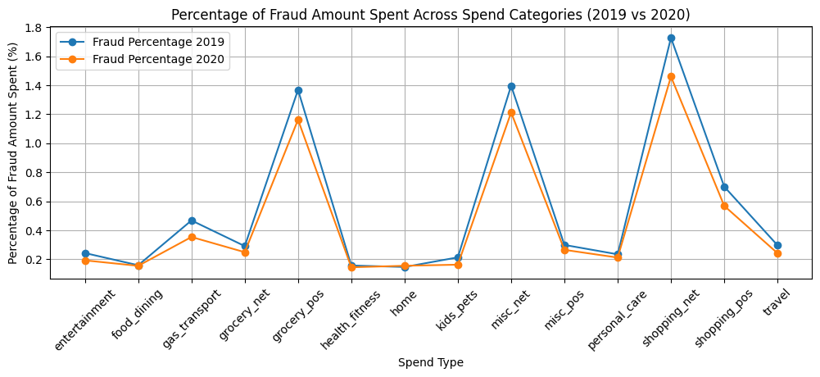
Transactions for different spend types
Maximum fraud amount spent on internet shopping, and point of sale grocery shopping.

Slide 12
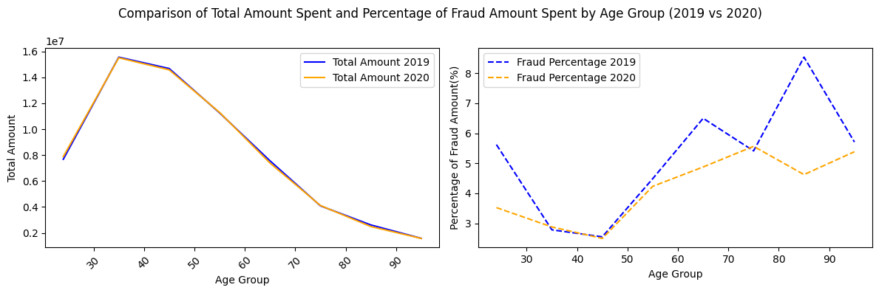
Spend by Different Age Groups
The age groups 31-40 are spending more and are less prone to fraud transactions.
The percentage of fraud transactions for age group 60-90 is higher; however, reduced considerably in 2020.

Slide 13
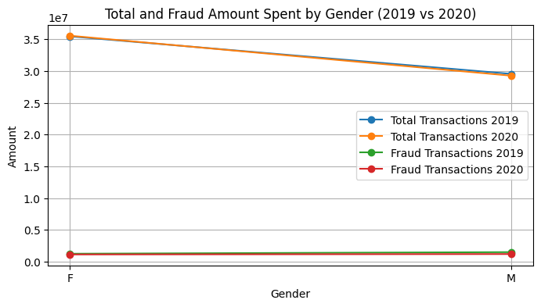
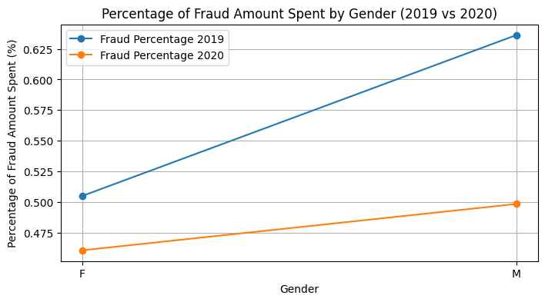
Spend by Different Genders
Amount of fraud spend is similar for both genders while Females spend more than males and therefore percentage of fraud transactions for females is lesser.

Slide 14
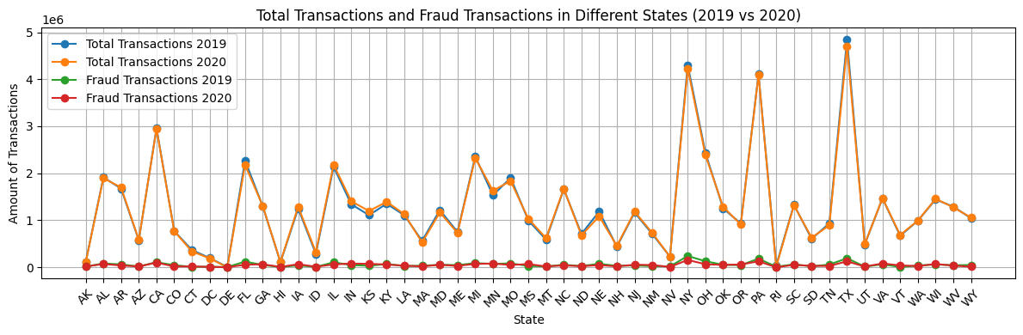
Spend in different States
Amount of fraud spend is similar across all states in both years.
Highest transactions are made by Texas followed by new york and Pennsylvania.

Slide 15
Model development and validations
01
Data splitting
Test Data
Train Data
02
Model Comparison
Logistic Regression
XGBoost
Artificial Neural Network
03
Model Evaluation Metrics
Accuracy
AUC-ROC

Slide 16
Model Comparisons
Model | Accuracy | AUC-ROC | Strengths
LOGISTIC REGRESSION | 0.90 | 0.81 | Interpretable.
XGBOOST | 0.99 | 0.93 | High predictive Accuracy. Handles complex relationships.
ANN | 0.98 | 0.99 | Capture complex patterns. Highly flexible and adaptable.
Model Finalization
ANN has the highest AUC-ROC; however, it seems to be overfitting; therefore, the best model here is XGBoost.

Slide 17
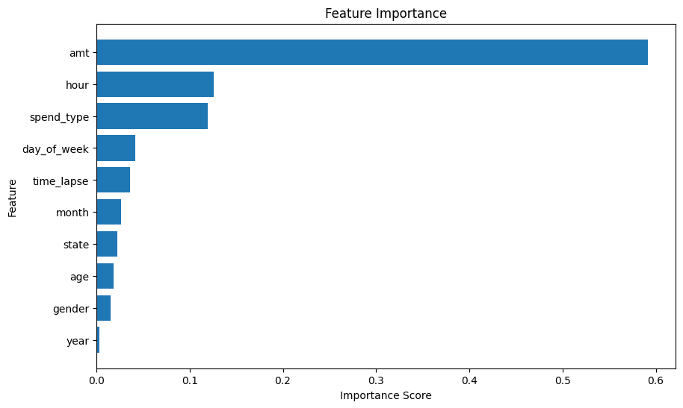
Features used to Train ML Model

Slide 18
Business Recommendations and Potential Business Impact
We analysed that the dent fraud transactions made was 3.95% of the total amount spent and; hence, it is imperative to include an effective business system for fraud detection.
We further notice that the amount of fraud transaction was higher during 10:00 pm till 03:00 am; hence, more vigilance should be kept at that time.
As per our analysis, maximum fraud transactions occurred online and therefore, measures should be introduced to make online transactions more secure.
Also, it will be helpful to place restrictions on the amount and number of transactions that can be made on physical cards without requiring pin verification.

Slide 19
Also, amount of fraud transactions are majorly similar across different months, states, gender and percentage of fraud is influenced more by the total amount spent; hence, fraud detection has to be paired with building a security system that is customer friendly and efficient. This can be achieved by:
Introducing digital platform that is easy to understand and work with.
Hiring competent customer facing personnels, and constantly monitoring customer interactions.
Constantly reviewing customer feedback and grievances.
Timely resolving customer concerns.

Slide 20
Thank You

